Slide 1
Computer Graphics Models
László Szécsi szecsi@iit.bme.hu
AIT

Slide 2
Game objects and model geometries
GameObject
Mesh
Material
vertex shader
fragment shader
modellmátrix
Geometry
*
vertex buffer
uniform setting
index buffer
texture

Slide 3
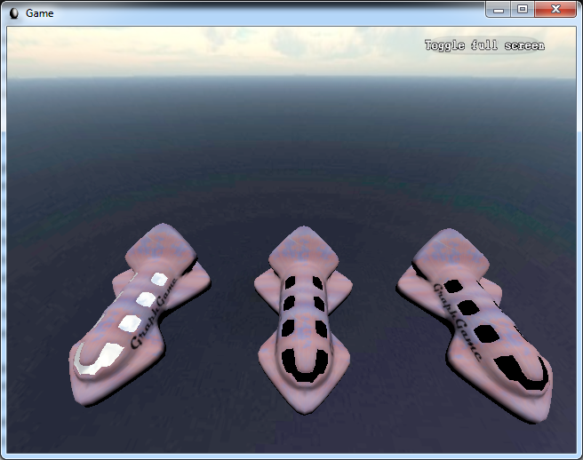
Submesh

Slide 4
Game objects and model geometries
MultiMesh
GameObject
Mesh
Material
vertex shader
fragment shader
modellmátrix
SubMeshGeometry
vertex buffer
QuadGeometry
*
uniform setting
index buffer
texture

Slide 5
JSON model file format
designed for WebGL
easy to load from Kotlin
contains data in ready-to-use-in-buffers format
download model from Moodle
or convert your own using Blender
see the Blender slides and video
use the script on Moodle

Slide 6
Geometry loaded from file
create new SubmeshGeometry.kt similar to TexturedQuadGeometry.kt
constructor takes an object, describing a mesh as loaded from JSON file, having the properties:
property vertices: 3n coordinates in continuous array
property normals: 3n elements in continuous array
property texturecoords: array (typically with a single element, as the model has only one set of texture coordinates) of continuous arrays of 2n elements
property faces: array of n arrays of 3 indices
make continuous (and proper 16-bit int type) array using
val indexIterator = jsonMesh.faces.flatten().iterator()
val indexArray = Array<Short>(indexCount) {indexIterator.next()}
texturecoords[0]
the expressions in red replace array literals
but wrapping them in typed arrays must remain

Slide 7
Geomety from JSON
jsonMesh.vertices
jsonMesh.normals
jsonMesh.texturecoords[0]
these replace array literals
gl.bindBuffer(GL.ARRAY_BUFFER, vertexBuffer)
gl.bufferData(GL.ARRAY_BUFFER,
Float32Array(arrayOf<Float>(
-1.0f, -1.0f, 0.5f,
-1.0f, 1.0f, 0.5f,
1.0f, -1.0f, 0.5f,
1.0f, 1.0f, 0.5f
)),
GL.STATIC_DRAW)

Slide 8

Index buffer
flattened array
We need this in the draw method
val indexBuffer = gl.createBuffer()
val indexCount = jsonMesh.faces.flatten().size
init{
val indexIterator = jsonMesh.faces.flatten().iterator()
val indexArray =
Array<Short>(indexCount) {indexIterator.next()}
gl.bindBuffer(GL.ELEMENT_ARRAY_BUFFER, indexBuffer)
gl.bufferData(GL.ELEMENT_ARRAY_BUFFER,
Uint16Array( indexArray ),
GL.STATIC_DRAW)
}
Short array to make a Uint16Array

Slide 9
MultiMesh concept
a UniformProvider component
a collection of meshes (called submeshes)
MultiMesh#draw is UniformProvider#draw
which just calls draw for all submeshes
constructor takes arrays of materials and geoemetires
creates the submeshes
using the SubmeshGeometry constructor

Slide 10
MultiMesh.kt
the same number of materials and geometries
class MultiMesh(
materials : Array<Material>,
geometries : Array<Geometry>
) : UniformProvider("multiMesh") {
init {
if(materials.size != geometries.size){
throw Error("MultiMesh has ${geometries.size} geometries, but ${materials.size} materials were provided.")
}
val submeshes = Array<Mesh>(geometries.size) {
i -> Mesh(materials[i], geometries[i])
}
addComponentsAndGatherUniforms(*submeshes)
}
}
our compnents are the meshes

Slide 11
JsonLoader.kt
import org.w3c.xhr.XMLHttpRequest
import org.w3c.dom.events.*
import kotlinx.serialization.*
import kotlinx.serialization.json.*
@Serializable
data class JsonMesh(
val vertices : Array<Float>,
val normals : Array<Float>,
val texturecoords : Array<Array<Float>>,
val faces : Array<Array<Short>>)
@Serializable
data class JsonModel(
val meshes : Array<JsonMesh>)

Slide 12
JsonLoader.kt
from this string
fun load(gl : WebGL2RenderingContext,
jsonModelFileUrl : String) : Array<Geometry> {
val request = XMLHttpRequest()
request.overrideMimeType("application/json")
request.open("GET", jsonModelFileUrl, false)
var geometries : Array<Geometry>? = null
request.onloadend = {
val json = Json { ignoreUnknownKeys=true }
val jsonModel = json.decodeFromString(
JsonModel.serializer(), request.responseText)
geometries = Array<Geometry>(jsonModel.meshes.size) {
i -> SubmeshGeometry(gl, jsonModel.meshes[i])
}
Unit
}
request.send()
return geometries!!
}
make these
fill the array
mesh geometry as given in the JSON object

Slide 13
GameObject.kt – MultiMesh is allowed as the child component, not only Mesh
open class GameObject(
mesh : UniformProvider,
val position : Vec3 = Vec3.zeros.clone(),
var roll : Float = 0.0f,
val scale : Vec3 = Vec3.ones.clone()
) : UniformProvider("gameObject") {
this could be anything

Slide 14
Use MultiMesh to display 3D object
create materials for both submeshes
same program, different texture
create MultiMesh, pass array of materials
create game object using the multi mesh

Slide 15
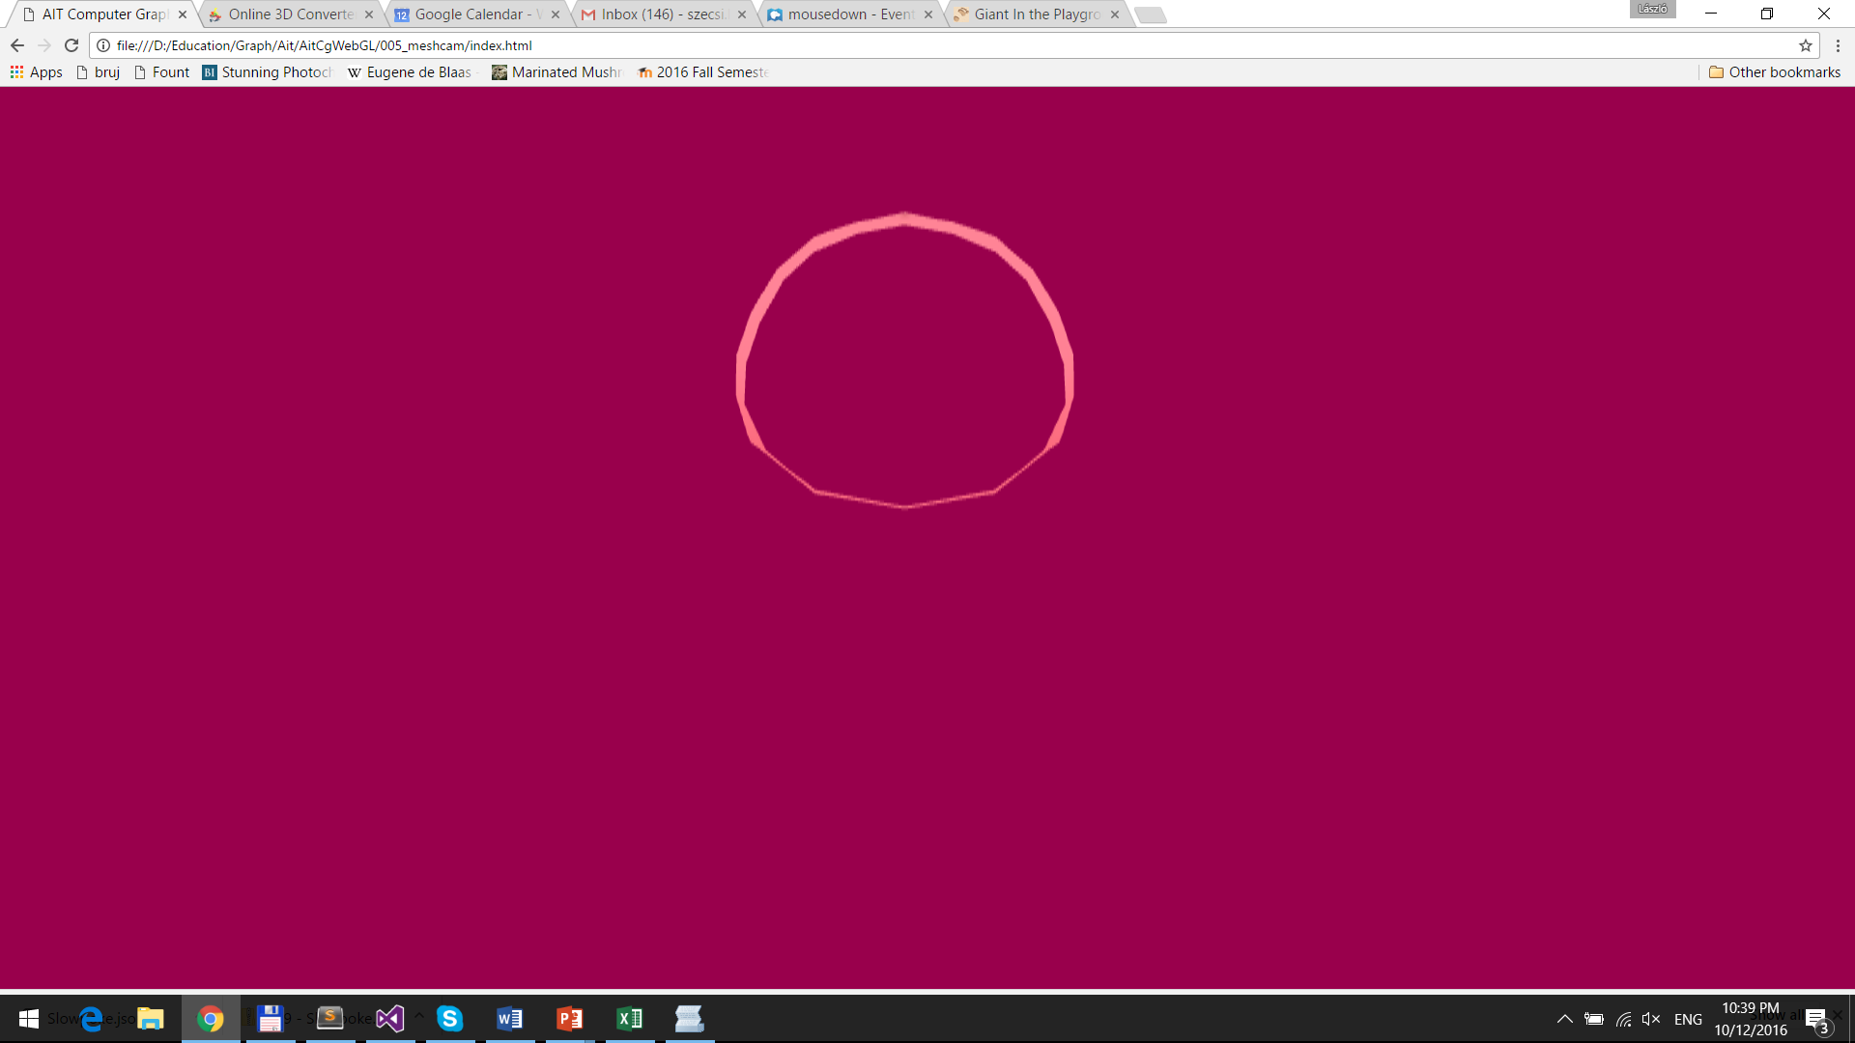
Part of object that coincides with visible area shown (your camera may be different)

Slide 16
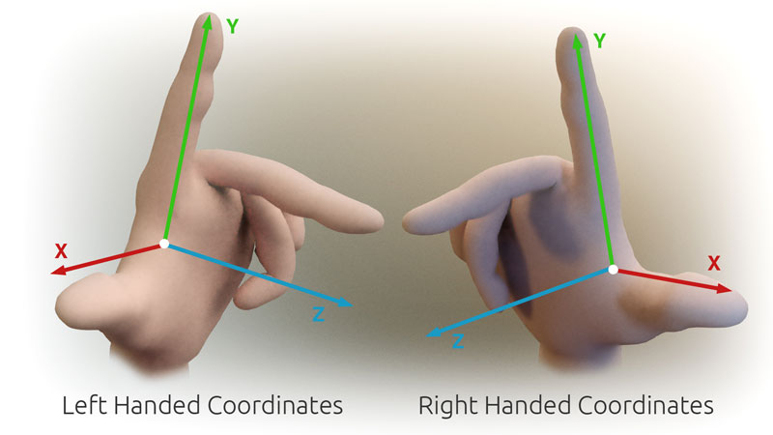
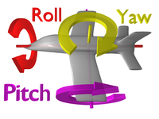
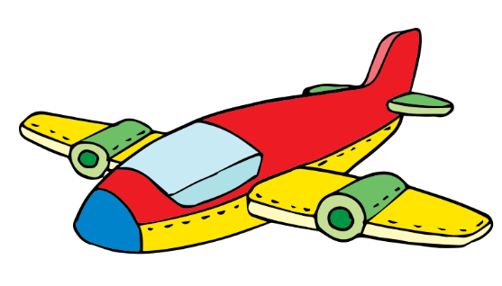
Yaw-pitch-roll: a way to specify 3D orientation
right-handed coordinates
main directions
x: right
y: up
z: back (ahead is -z)
rotation angles:
yaw – around y
pitch – around x
roll – around z
y
x
z

Slide 17
3D rotation in GameObject
modelMatrix.set().
scale(scale).
rotate(roll).
rotate(pitch, 1.0f, 0.0f, 0.0f).
rotate(yaw, 0.0f, 1.0f, 0.0f).
translate(position)
properties roll, pitch, yaw replace orientation
in GameObject#update

Slide 18
Make object fully visible
set game object scale (approx. 0.1, 0.1, 0.1)
rotate (e.g. half π around the vertical axis)
enable depth testing to avoid further away parts showing through
gl.enable(GL.DEPTH_TEST)
avoid transparency
either disable alpha blending
or make sure your fragment shaders sets unit alpha

